Slide 1



LIST COMPREHENSIONS
Python is famous for allowing you to write code that’s elegant, easy to write, and almost as easy to read as plain English.
One of the language’s most distinctive features is the list comprehension, which you can use to create powerful functionality within a single line of code.

Slide 2
Comprehensions
Comprehensions are constructs that
allow sequences to be built from other sequences.
Python supports three kinds of comprehensions
1. List comprehension
2. Dictionary comprehension
3. Set comprehension

Slide 3

List comprehension
The components of a list comprehension are:
Output Expression (Optional)
Iterable
Iterator variable which represents the members of the iterable

Slide 4
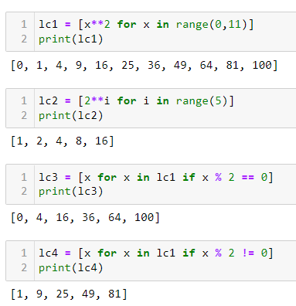

Slide 5
Example on List comprehension
even_squares = []
for num in range(0,10):
if num%2 == 0:
even_squares.append(num * num)
print(even_squares)
even_squares = [num * num for num in range(0,11) if num%2 == 0]
even_squares

Slide 6
Adv of List comprehension
is an elegant way to define and create lists based on existing lists
more compact and faster than normal functions and loops for creating list
Drawback
avoid writing very long list comprehensions in one line
to ensure that code is user-friendly

